Slide 1




Technologies
In-House
Level Building Script

Slide 2
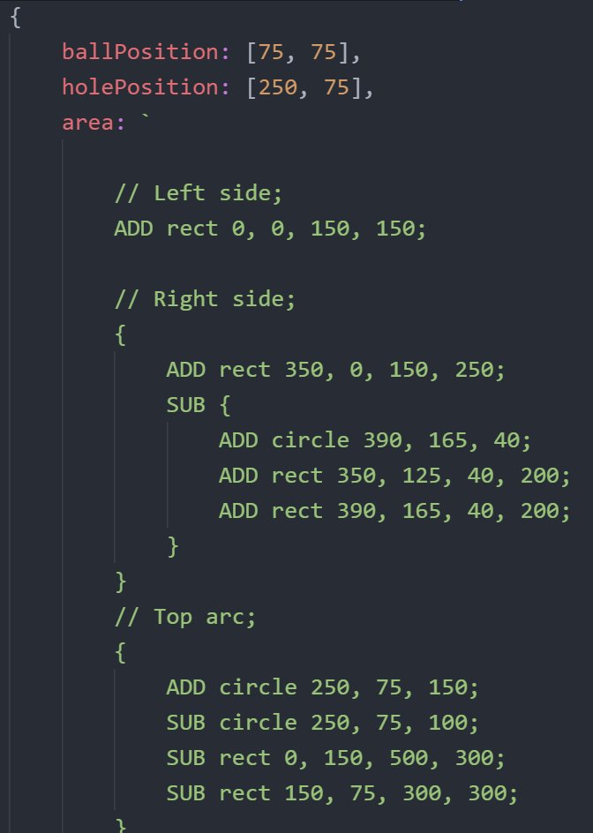
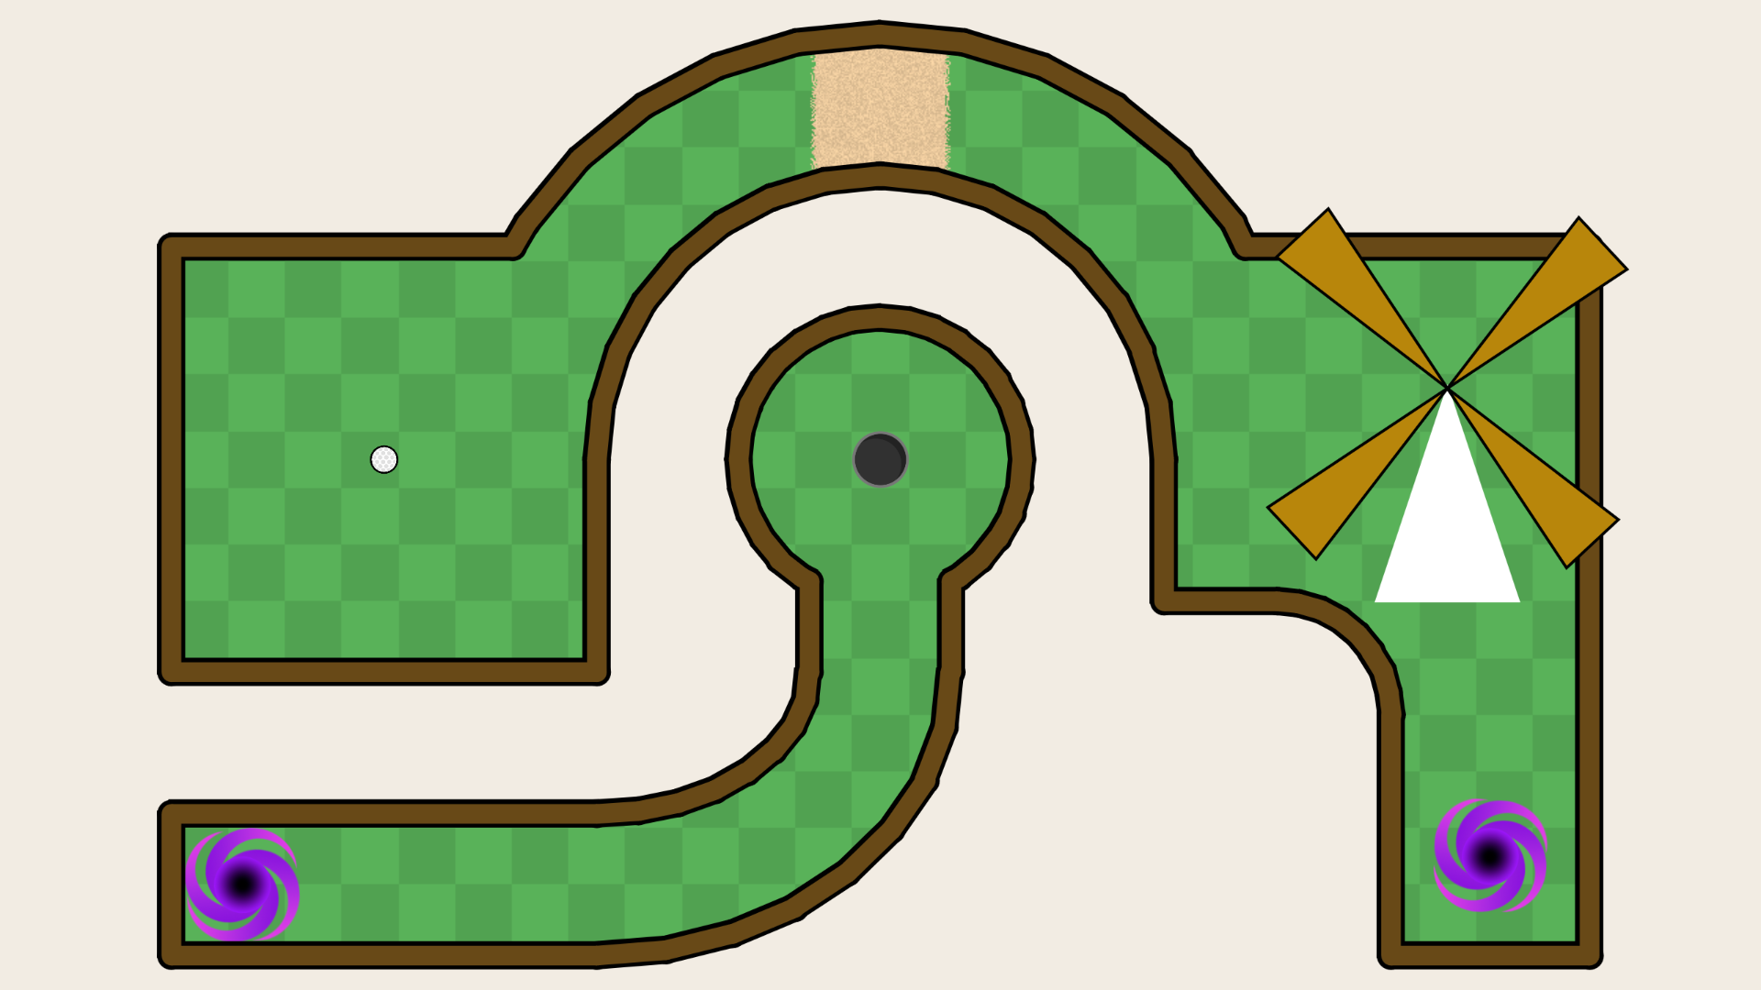
Level Builder
Notes:
Level Generation - Darien

Slide 3
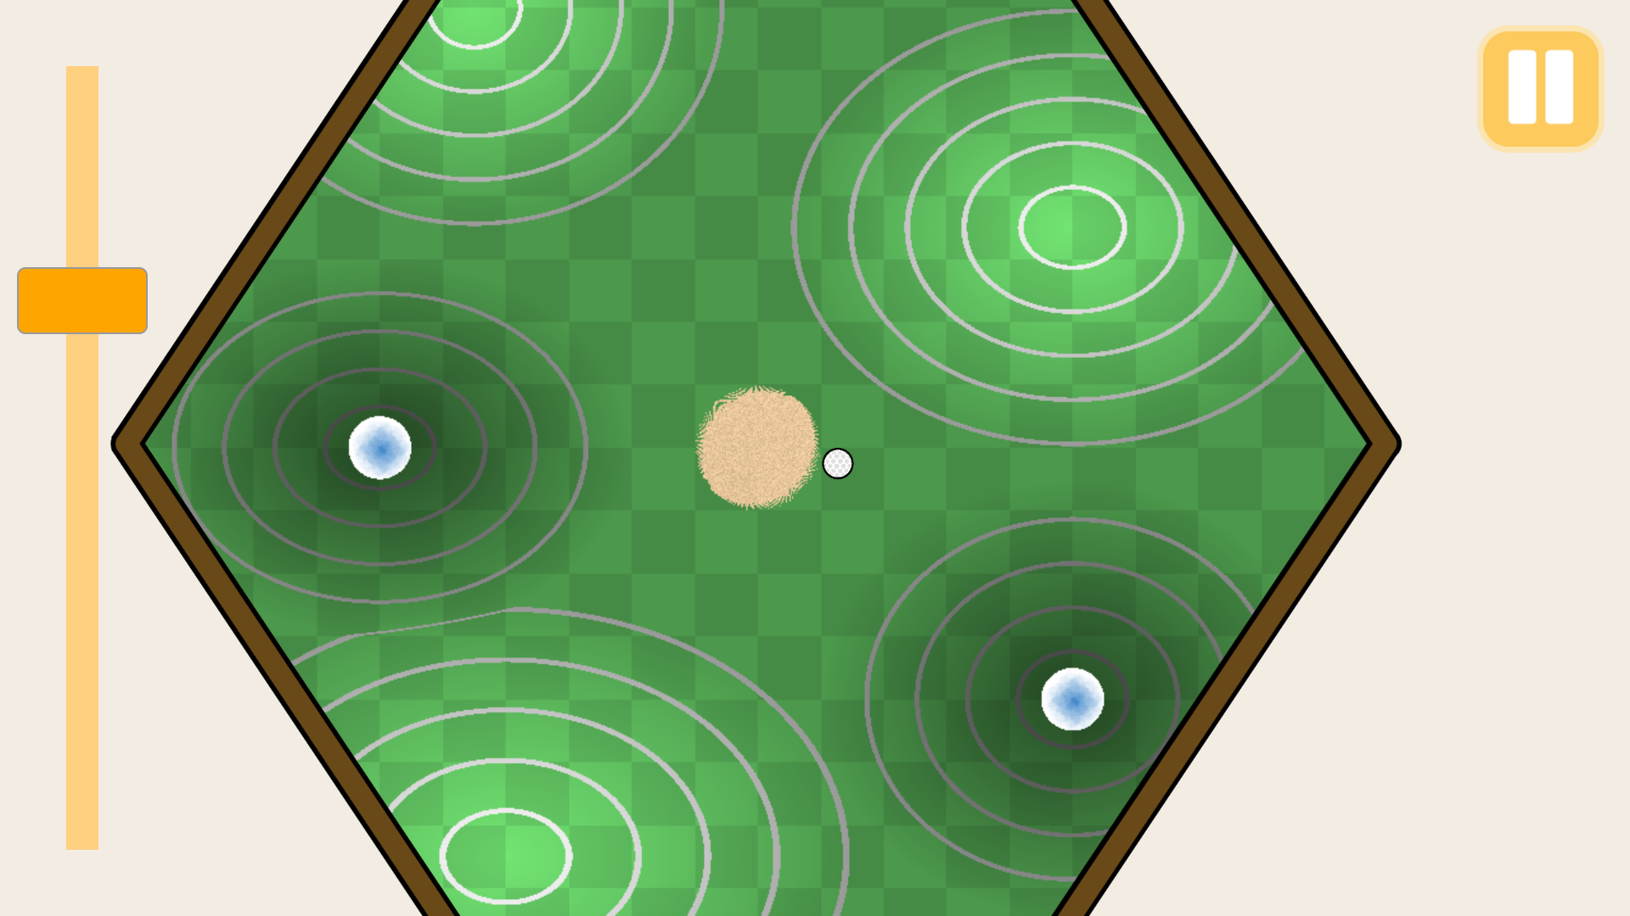

Slide 4
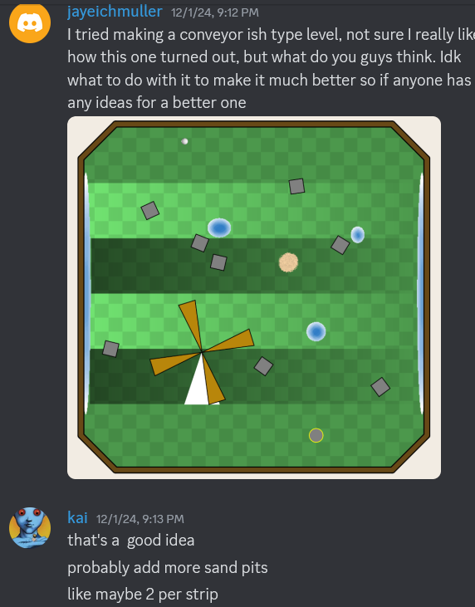
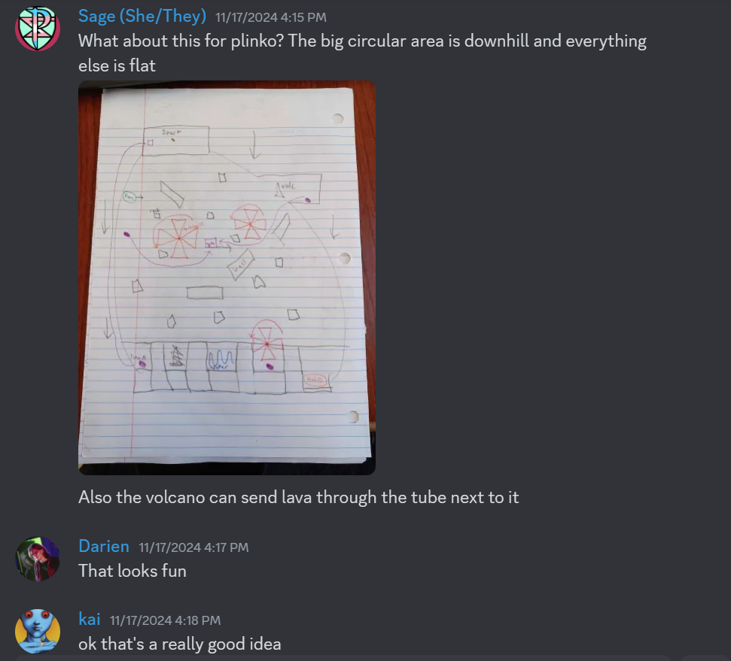

Slide 5
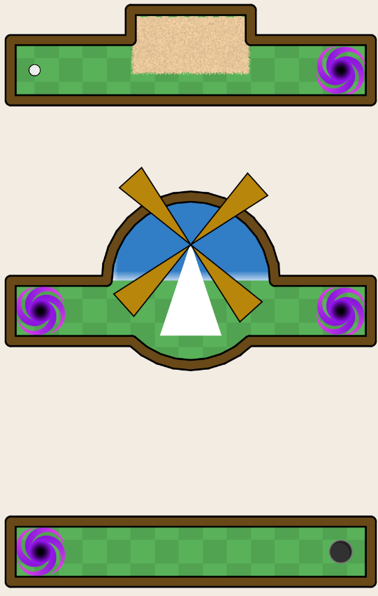
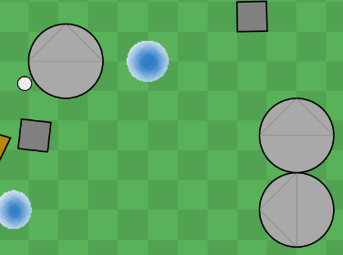

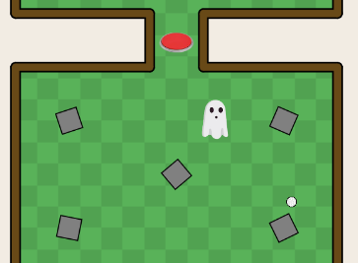

Slide 6
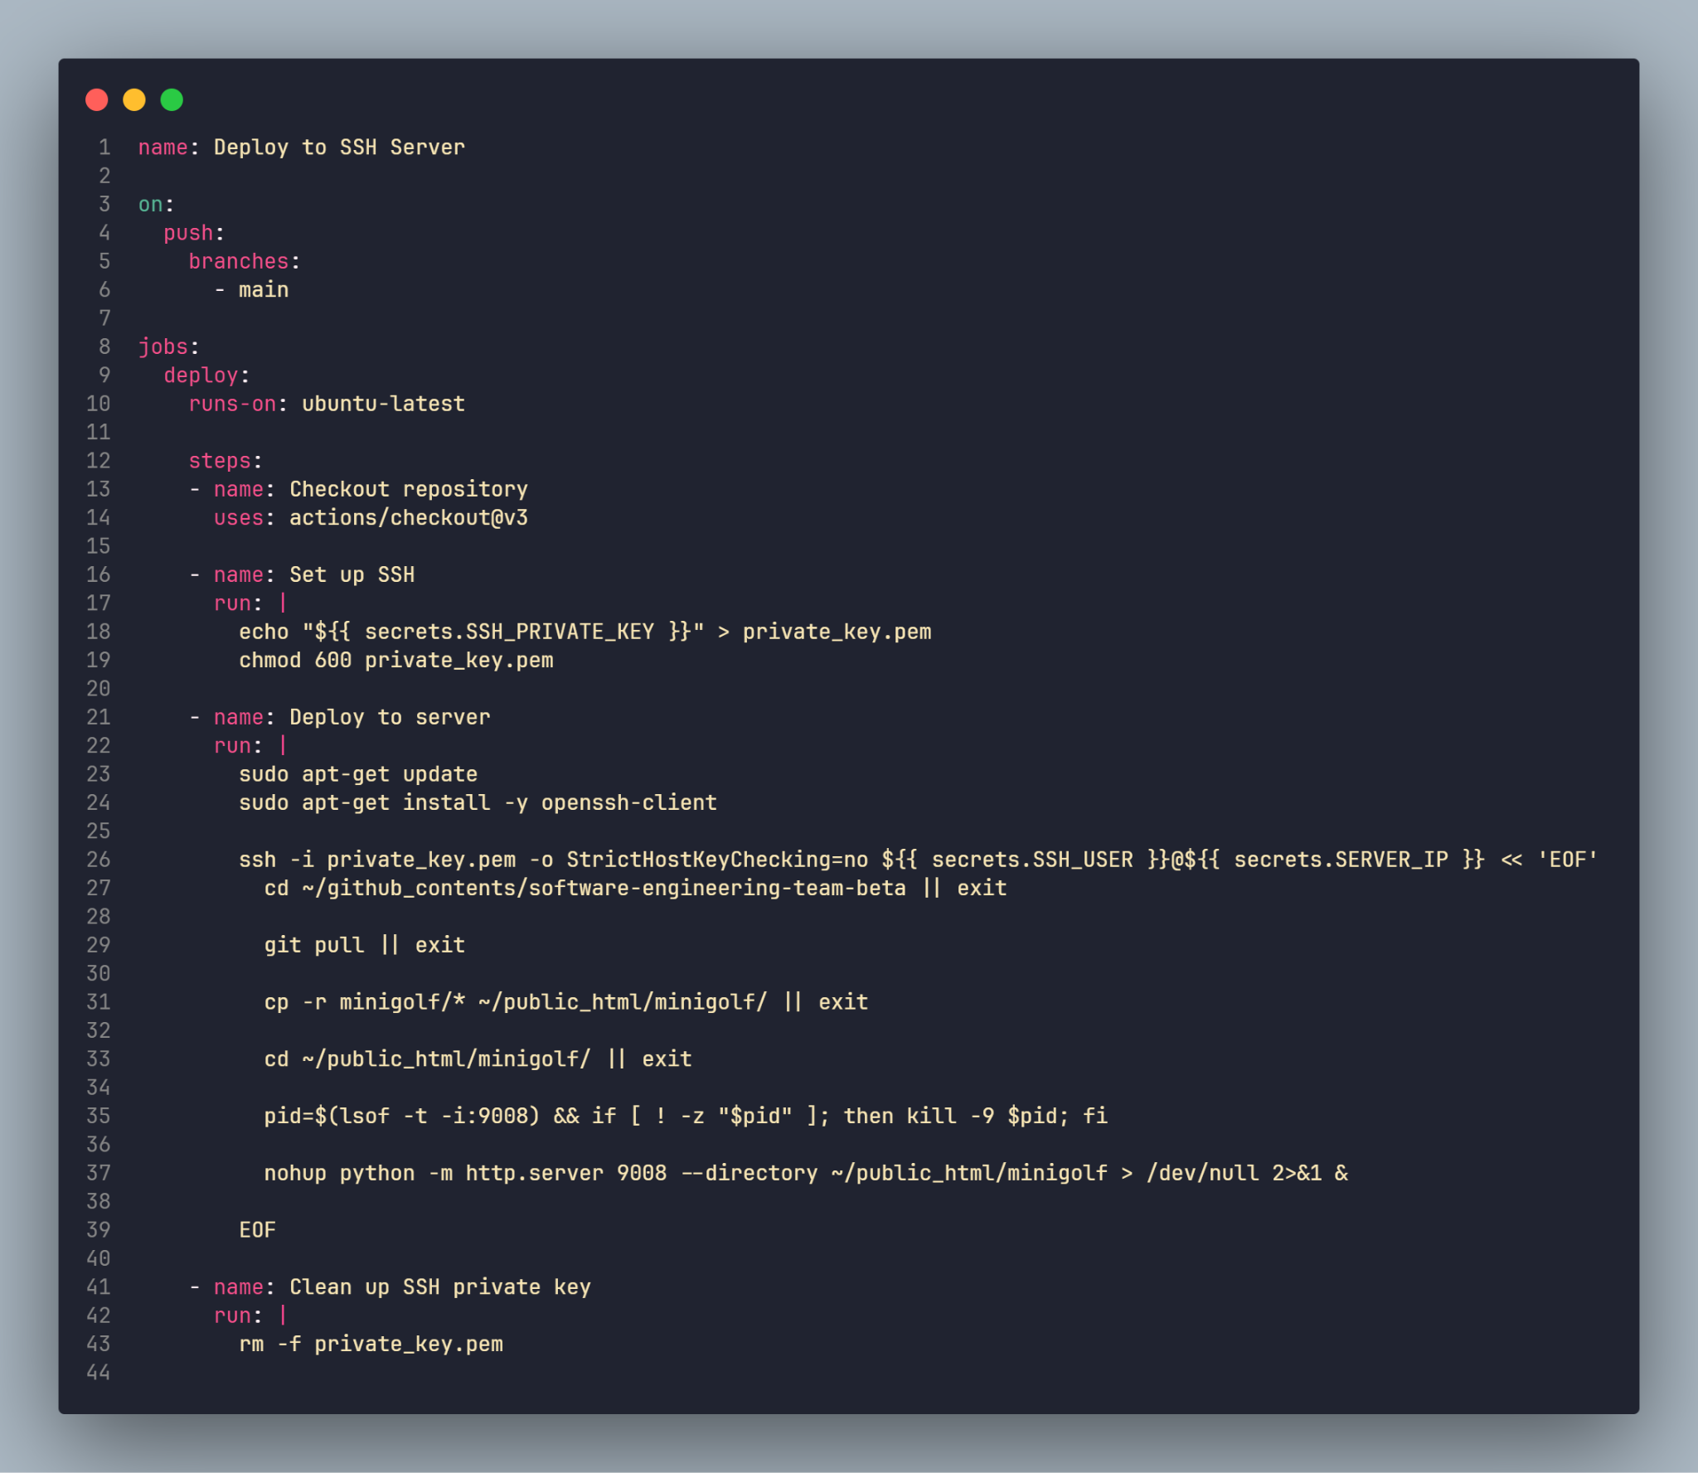
Deployment
Notes:
Commit to Main
Script runs on Github Actions
Connect to Cassini via SSH
Pull most recent commit to Cassini
Start HTML Server

Slide 7
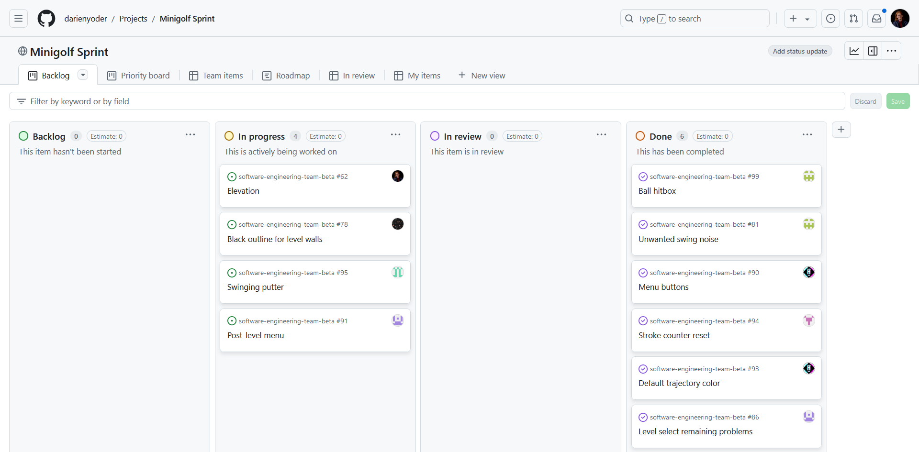
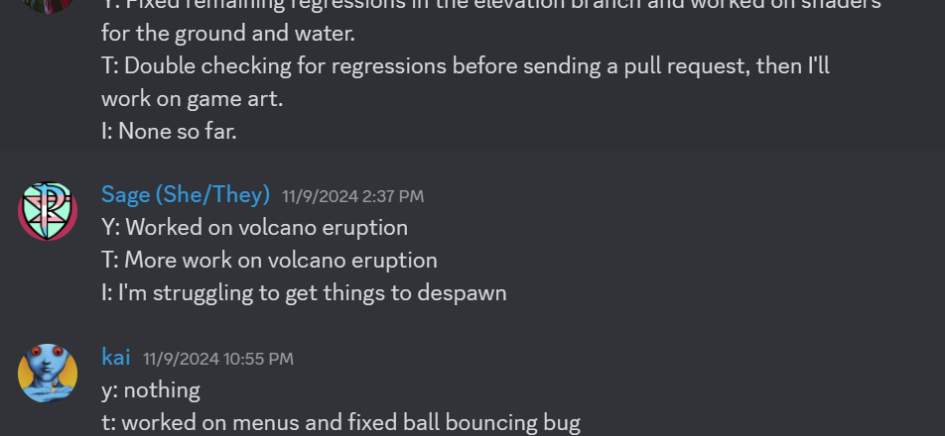
Scrum
Methodology
Notes:
Commit to Main
Script runs on Github Actions
Connect to Cassini via SSH
Pull most recent commit to Cassini
Start HTML Server

Slide 8
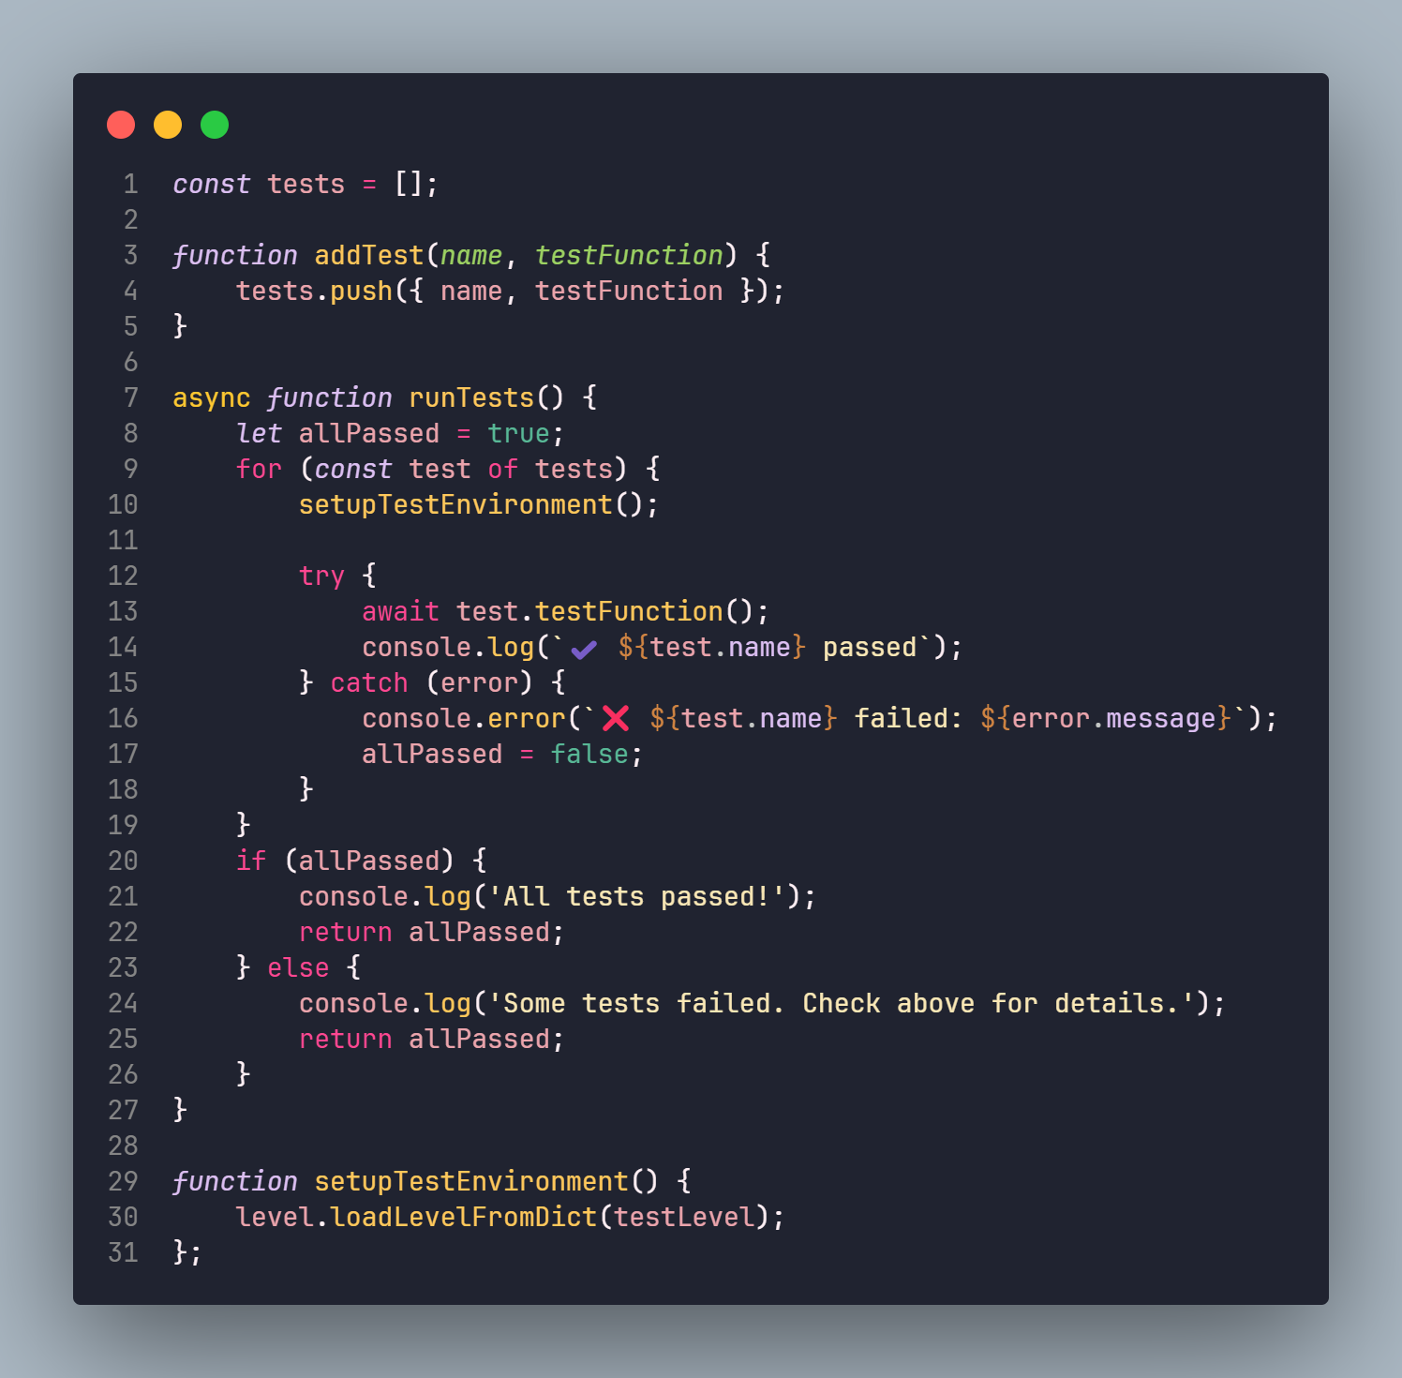
Automated Testing
Simple Framework
Webdriver & Python
Github Actions Runner

Slide 9
Stakeholder
“When it comes to the project, I'm very satisfied with what the group was able to produce. The game is very fun and challenging and as someone who isn't really into golf games I had a lot more fun playing than I thought I would. All together I think the group did an amazing job and it was really cool to see them work together, constantly bringing new ideas to the table to make the game more interesting.”
-Logan Horvath

Slide 10
Thank you!
cassini.cs.kent.edu/minigolf

